Slide 1
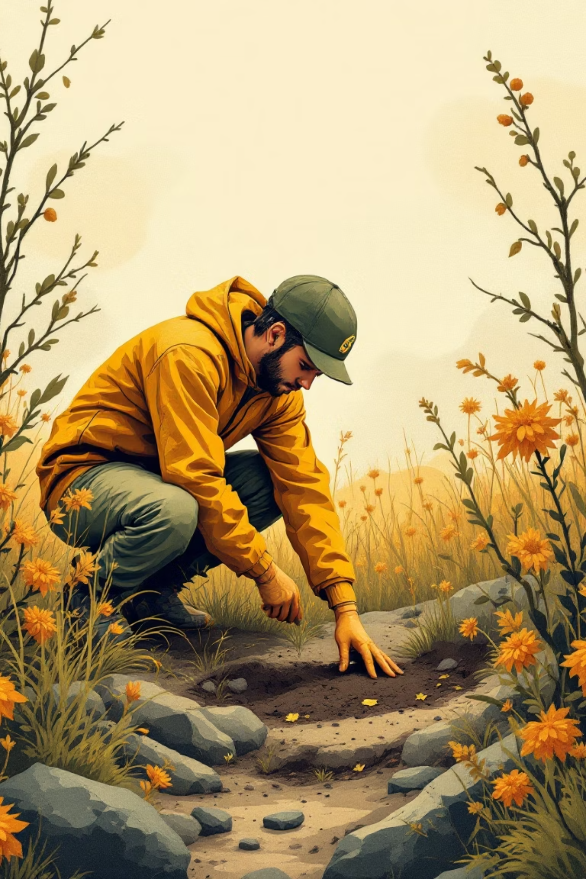
Post-War UXO Identification
EECE 693 WiDS Hackathon Report
Sustainable Rebuilding Through Computer Vision
Lynn Ariss, Tamara Fakih, Dana Kossaybati, Omar Ramadan, Zeinab TakachFall 2025–2026 | October 28th, 2025

Slide 2


The Challenge: Rebuilding Amid Hidden Danger
After the 2024 war, South Lebanon faces a critical challenge: rebuilding while surrounded by unexploded ordnance (UXO) that threaten lives and delay reconstruction.
Responders and civilians need rapid, reliable ways to identify UXO types and understand appropriate safety protocols.
The Goal: Use AI-powered computer vision to classify UXO from images, enabling safer triage and linking each type to proven safety guidance.

Slide 3

Our Approach: AI as a Safety Tool
What This Is
What This Isn't
Awareness and triage aid
Not a clearance tool
Single-image classification
Not a replacement for human experts
Links UXO types to safety rubrics
Not meant for field deployment without validation
Supports sustainable rebuilding
Advancing UN SDGs 9 (Infrastructure), 11 (Cities), and 16 (Peace & Justice)

Slide 4
Dataset & Classification Task
We trained on UXORD-10K, a carefully curated dataset of UXO imagery with eight distinct classes.
8 Classes
Training Split
Aircraft-bombs, fuzes, grenades, landmines, mortars, projectiles, rockets, submunitions
3,949 images
Validation Split
Test Split
237 images
431 images
First step toward future detection and segmentation workflows

Slide 5

Model 1: YOLOv8-cls Baseline
Transfer Learning Approach: We leveraged ImageNet-pretrained YOLOv8n-cls to accelerate convergence and improve generalization.
Input & Batch
224×224 | Batch: 128
Optimizer
AdamW (lr=1e-3)
Regularization
Weight decay: 5e-4
Training
40 epochs | Early stopping (patience=10)
Augmentations: flips, RandAugment, erasing | Framework: PyTorch + Ultralytics 8.3.x on Google Colab (Tesla T4)

Slide 6

Model 2: Lightweight & Field-Ready
MobileNetV3-Small
Optimized for mobile and edge deployment. Smaller footprint, faster inference.
Input Size
Regularization
320×320
Label smoothing: 0.1
Learning Schedule
CosineAnnealingLR
Augmentations: crops, flips, color jitter, erasing

Slide 7
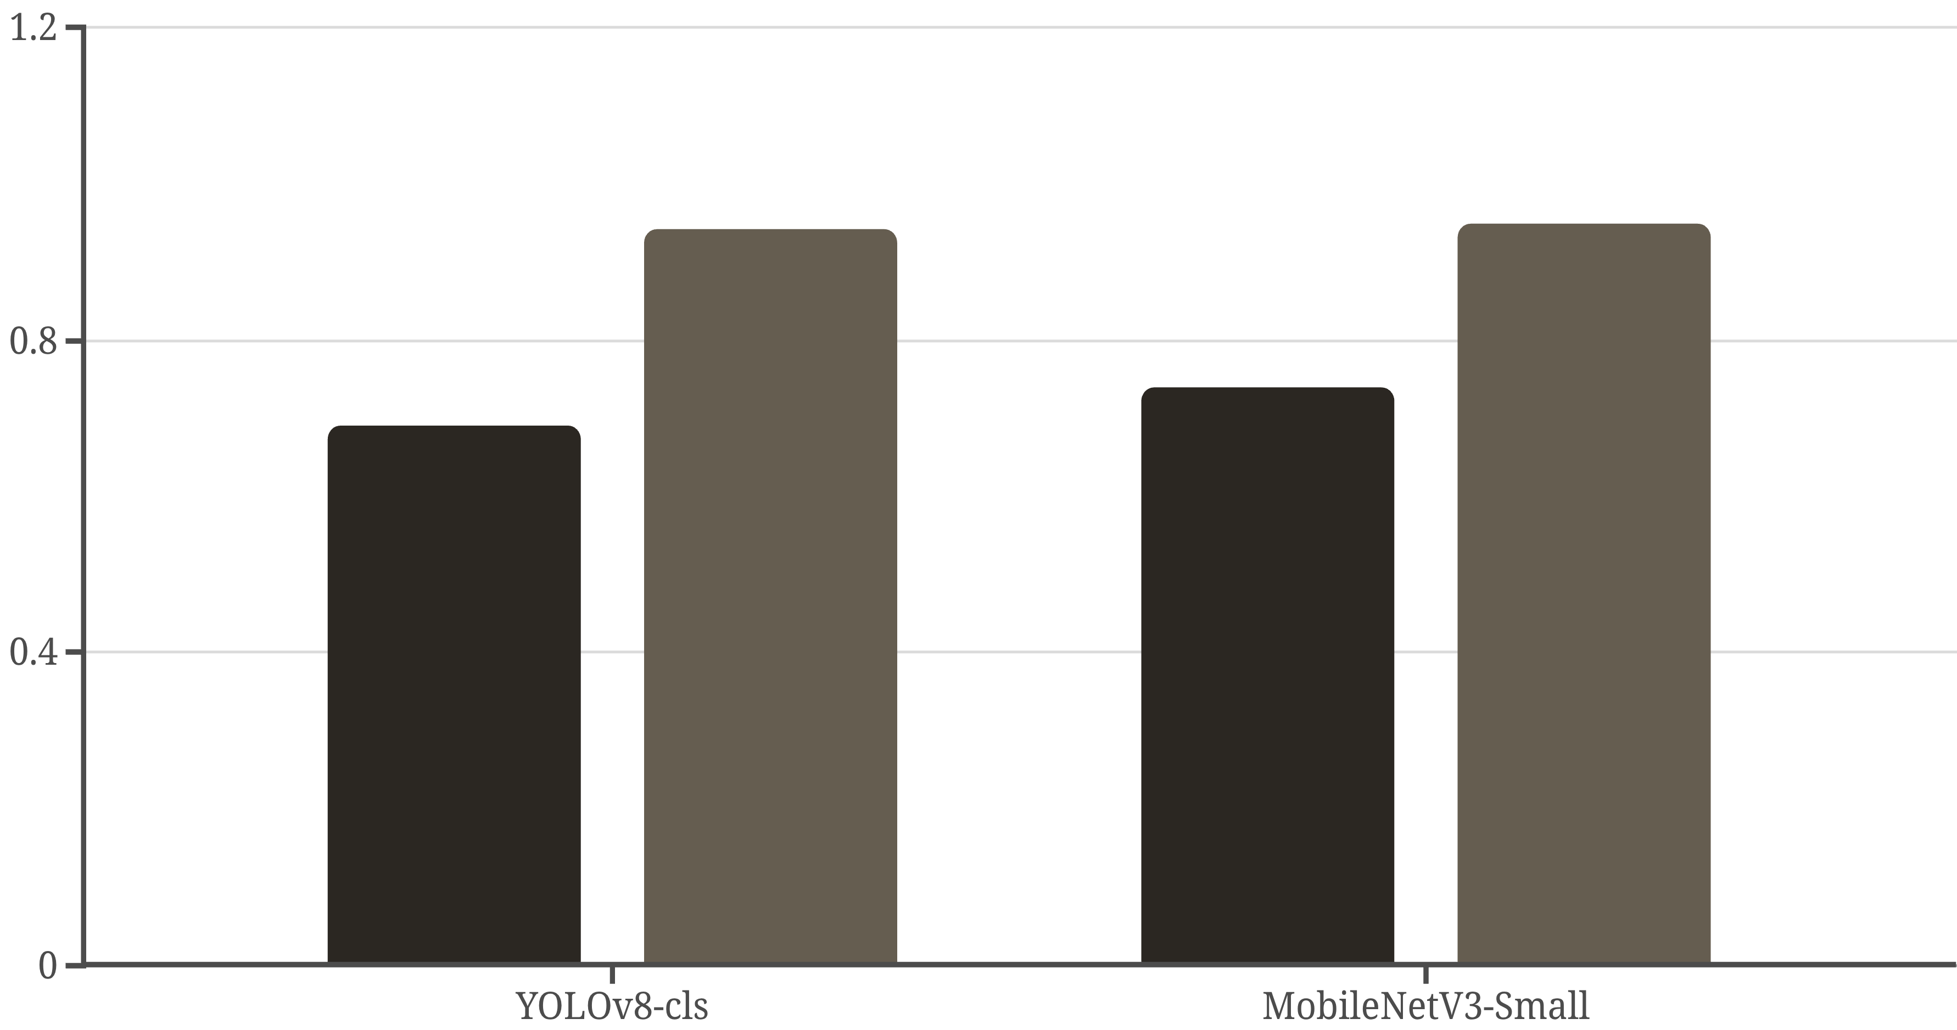
Results: Classification Accuracy
Our models achieved strong performance across both metrics, with MobileNetV3-Small edging out the larger baseline.
Top-1 Accuracy
Top-5 Accuracy
Insight: MobileNetV3 outperformed YOLOv8 by 4–5 percentage points in Top-1 accuracy while remaining lightweight and deployment-friendly.

Slide 8
Per-Class Performance Breakdown
Performance varied significantly by class, revealing both strengths and areas for improvement.
1
2
Strong Performers
High Precision
Aircraft-bombs (F1 ≈ 0.83) and projectiles (F1 ≈ 0.81) show robust discriminability. High precision and recall enable confident identification.
Fuzes and mortars (precision ≈ 0.9) are rarely misclassified, but low recall means some go undetected. Trade-off between false alarms and missed detections.
3
4
High Recall
Challenging
Landmines (recall ≈ 0.91) are caught frequently, yet precision lags (≈ 0.61). More false positives, but fewer life-threatening misses.
Rockets and submunitions remain difficult (F1 ≈ 0.6). Visual similarity and dataset imbalance contribute to lower performance.

Slide 9


From Identification to Safety Action
Classification alone is valuable only when it guides real-world safety decisions. Each predicted UXO class links directly to proven safety rubrics.
Do Not Touch or Move
Mark & Notify
Responder Protocol

Slide 10

Sustainability
& Impact

Slide 11

🏗️ Infrastructure Sustainability
Enables safer rebuilding of roads, power lines, and public spaces.
Prevents accidents during construction and restoration.

Slide 12

🏥 Healthcare Resilience
Reduces UXO-related injuries and hospital strain.
Promotes proactive risk prevention, not just emergency response.

Slide 13

👨‍👩‍👧‍👦 Social Sustainability
Supports safe resettlement and farming.
Restores confidence and stability in post-conflict communities.

Slide 14

Alignment with UN SDGs
Goal 9: Industry & Infrastructure
Goal 11: Sustainable Cities & Communities
Goal 16: Peace, Justice & Strong Institutions

Slide 15

Market Opportunity
Global UXO clearance and post-conflict rebuilding market: $3-5 billion annually.
Target users: NGOs, governments, UN agencies, and reconstruction companies.
Applicable in Lebanon, Ukraine, Iraq, Sudan, Gaza, and beyond.
Practical Implementation

Slide 16
Financial Plan
Freemium Model
Subscription for Organizations
Practical Implementation
free for awareness and safety training
premium for analytics & mapping.
needing large-scale deployment or data insights.

Slide 17
Future Work
🧭 Model Expansion
Improve accuracy under real-world lighting and terrain conditions.
🗺️ UXO Mapping & Risk Prediction
Develop heatmaps of UXO hotspots.
Integrate with GIS / drone data for large-area analysis.
🗣️ Localization & Accessibility
Add Arabic language guidance and regional UXO datasets.
Design offline and mobile-friendly versions for field use.
🤝 Partnerships & Deployment
Collaborate with NGOs, governments, and UN agencies.
Pilot real-world testing in affected areas (e.g., South Lebanon).

Slide 18
UXO AI
Rebuilding the future, one safe step at a time.

